Slide 1


K.RAMAKRISHNAN COLLEGE OF TECHNOLOGY
(AUTONOMOUS), TRICHY.
TIC-TAC-TOE GAME
SUPERVISOR
Mr. M. Saravanan, M.E.,
AP/CSE.
PRESENTED BY:
Name of the Student: R.Crosini Infanteena
Reg No:2303811710422021

Slide 2
PRESENTATION OVERVIEW
Objective
Project Introduction
Problem Statement
Methodologies (Programming concepts relevant to problem statement)
Architecture of the proposed system
List of Modules
Merits
Results and Discussion
Queries

Slide 3
OBJECTIVE
The objective of this Tic-Tac-Toe game implementation in Java is to create a simple, interactive, console-based game for two players. It demonstrates key programming concepts like handling user input, using arrays for the game board, and implementing win/draw conditions.
The project focuses on modular design for readability and error handling for smooth gameplay. Additionally, it promotes problem-solving skills through logical game flow and structured methods.

Slide 4
PROJECT INTRODUCTION
Tic-Tac-Toe is a classic two-player game that serves as a great introduction to programming concepts. This Java implementation provides a simple, console-based version where players take turns to compete in marking their symbols on a 3x3 grid. The project emphasizes handling user input, validating moves, and checking win/draw conditions through logical algorithms. With a modular design approach, the game logic is structured into methods for better readability and maintainability.

Slide 5
PROBLEM STATEMENT
Design and implement a console-based Tic-Tac-Toe game in Java that allows two players to compete in a turn-based manner. The game should use a 3x3 grid to represent the board and provide functionality to handle user input, validate moves, and determine the outcome (win, lose, or draw).
The program must ensure smooth gameplay by preventing invalid moves and offering clear instructions and feedback to the players. The goal is to create a simple yet robust system that demonstrates key programming concepts, such as modular design, conditional logic, and error handling, while promoting problem-solving skills in game development.

Slide 6
METHODOLOGIES
Planning: Define objectives (2-player game, win/draw detection) and identify constraints (e.g., simple CLI, 3x3 board).
Initialization:
Setup board (initializeBoard()).
Gameplay Loop:
Alternate turns, validate moves, check game status.
Game Over Handling:
Display results, handle replay.
Test-Driven Development: Test key methods like checkWin(), isBoardFull(), and playerMove() individually before integration.
Error Handling: Handle invalid inputs (e.g., non-integers, out-of-bounds moves).

Slide 7
ARCHITECTURE OF THE PROPOSED SYSTEM
START GAME
DISPLAY BOARD
PLAYER MAKES MOVES
EXIT/PLAY AGAIN
CHECK WIN/DRAW
VALIDATE MOVE

Slide 8
LIST OF MODULES
MODULE DESCRIPTON
Game Board Module:
Purpose: Manages the 3x3 grid representation of the game board.
Functions:
Initialize an empty board.
Display the board after each turn.
Update the board with players' moves.
Input Handling Module:
Purpose: Captures and validates user input for gameplay.
Functions:
Accept and validate player moves.
Ensure moves are within bounds and not repeated.
Prompt for re-entry in case of invalid input.

Slide 9
Game Logic Module:
Purpose: Implements the rules and conditions of the game.
Functions:
Check for a win by verifying rows, columns, and diagonals.
Check for a draw when no moves are left and no winner exists.
Toggle between players after each turn.
Control Flow Module:
Purpose: Manages the overall flow of the game.
Functions:
Initialize and start the game.
Call relevant modules in sequence.
End the game with appropriate messages for win/draw conditions.
2/7/20

Slide 10
MERITS
Educational: Teaches basic programming concepts like arrays, loops, and conditional logic.
Interactive: Provides an engaging and fun game for two players.
Error Handling: Ensures smooth gameplay by validating user inputs.
Modular Design: Improves code readability and allows easy enhancements.
Skill Development: Encourages problem-solving and logical thinking through game design.

Slide 11
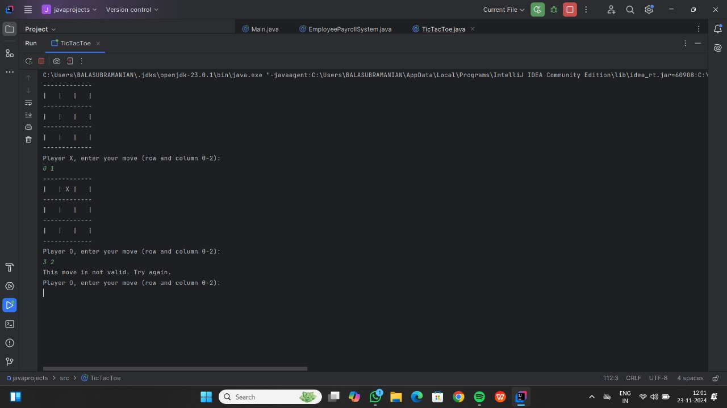
RESULTS AND DISCUSSION

Slide 12
QUERIES ?

